Slide 1
Discrete Mathematics
Dr. Han Huang
South China University of Technology
1

Slide 2
Chapter 5. Trees
Spanning Trees
Section 5.4
2

Slide 3
Contents
1
Introduction
2
Depth-First Search
3
Breadth-First Search
4
Backtracking Application
3

Slide 4
Introduction
4

Slide 5
A Road System
Old Town
Old Town
Etna
Etna
Herman
Herman
Orono
Orono
Bangor
Bangor
Hampden
Hampden
This problem was solved with a connected subgraph with the minimum number of edges containing all vertices of the original simple graph.

Slide 6
Definition 1
Let G be a simple graph. A spanning tree of G is a subgraph of G that is a tree containing every vertex of G.
A simple graph with a spanning tree must be connected, since there is path in the spanning tree between any vertices. The converse is also true, that is, every connected simple graph has a spanning tree.

Slide 7
Example 1 Find a spanning tree
Find a spanning tree of the simple graph G.
a
b
c
d
e
f
g
Edges removed: {a, e} {e, f} {c, g}

Slide 8
Spanning Trees of G
a
b
c
d
a
b
c
d
e
f
g
e
f
g
a
b
c
d
a
b
c
d
e
f
g
e
f
g

Slide 9
Theorem 1
A simple graph is connected if and only if it has a spanning tree.
Proof: First, suppose that a simple graph G has a spanning tree T.
T contains every vertex of G.
Furthermore, there is a path in T between any two of its vertices.
Since T is a subgraph of G, there is a path in G between any two of its vertices. Hence, G is connected.

Slide 10
Proof of Theorem 1
Now suppose that G is connected.
If G is not a tree, it must contain a simple circuit.
Remove an edge from one of these simple circuits.
The resulting subgraph has one fewer edge but still contains all the vertices of G and is connected.
This subgraph is still connected
because when two vertices are connected by a path containing the removed edge,
they are connected by a path not containing this edge.

Slide 11
Proof of Theorem 1
We can construct such a path by inserting into the original path,
at the point where the removed edge once was,
the simple circuits with this edge removed.
Repeat this process until no simple circuits remain.
This is possible because there are only a finite number of edges in the graph.

Slide 12
Proof of Theorem 1
The process terminates when no simple circuits remain.
A tree is produced since the graph stays connected as edges are removed.
This tree is spanning tree since it contains every vertex of G.

Slide 13
Example 2 : IP Multicasting.
Source
Router
Subnetwork
Subnetwork with a receiving station

Slide 14
Depth-First Search
14

Slide 15
The proof of Theorem 1 gives an algorithm for finding spanning trees by removing edges from simple circuits.
Instead of construction spanning trees by removing edges, spanning trees can be built up by successively adding edges.
Two algorithms based on this principle are presented here.

Slide 16
Algorithm : depth-first search.
1. Arbitrarily choose a vertex of the graph as the root.
2. Form a path starting at this vertex by successively adding vertices and edges, where each new edge is incident with the last vertex in the path and a vertex not already in the path.

Slide 17
Algorithm : depth-first search.
3. Continue adding vertices and edges to this path as long as possible.
4. If the path goes through all vertices of the graph, the tree consisting of this path is a spanning tree.
5. If the path does not go through all vertices, more vertices and edges must be added.

Slide 18
Algorithm : depth-first search.
6. Move back to the next to last vertex in the path, and, if possible, form a new path starting at this vertex passing through vertices that were not already visited.
7. If this cannot be done, move back another vertex in the path, that is, two vertices back in the path, and try again.

Slide 19
Example 3
a
d
i
j
f
c
e
k
h
g
b

Slide 20
Example 3
a
d
i
j
f
c
e
h
k
g
b
f
g
d
h
e
k
i
c
j
b
a

Slide 21
Example 3
The edges selected by a depth-first search of a graph are called tree edges.
All other edges of the graph must connect a vertex to an ancestor or descendant of this vertex in the tree.
These edges are called back edges.

Slide 22
Example 4
a
d
i
j
f
c
e
k
h
g
b
Back edges : ( e, f ) ( f, h )

Slide 23
Algorithm 1 : Depth-First Search
Procedure DFS (G: connected graph)
T := tree consisting only of the vertex v1
visit(v1)
Procedure visit (v : vertex of G)
for each vertex w adjacent to v and not yet in T
begin
add vertex w and edge {v, w} to T
visit(w)
end
O(e) or O(n^2) since e<=n(n-1)/2

Slide 24
Example 9
a
a
b
c
d
e
f
g
b
h
c
f
i
j
k
l
g
e
i
d
h
l
k
j
24

Slide 25
Breadth-First Search
25

Slide 26
Algorithm : breadth-first search.
1. Arbitrarily choose a vertex of the graph as the root.
2. Add edges incident to this vertex. The new vertices added at this stage become the vertices at level 1 in the spanning tree. Arbitrary order them.
3. For each vertex at level 1, visited in order, add each edge incident to this vertex to the tree as long as it does not procedure a simple circuit.

Slide 27
Algorithm : breadth-first search.
4. Arbitrarily order the children of each vertex at level 1. This produces the vertices at level 2 in the tree.
5. Follow the same procedure until all the vertices in the tree have been added.
6. The procedure ends since there are only a finite number of edges in the graph.
7. A spanning tree is produced since we have produced a tree containing every vertex of the graph.

Slide 28
Example 5
a
b
c
l
d
e
f
g
h
i
j
m
k

Slide 29
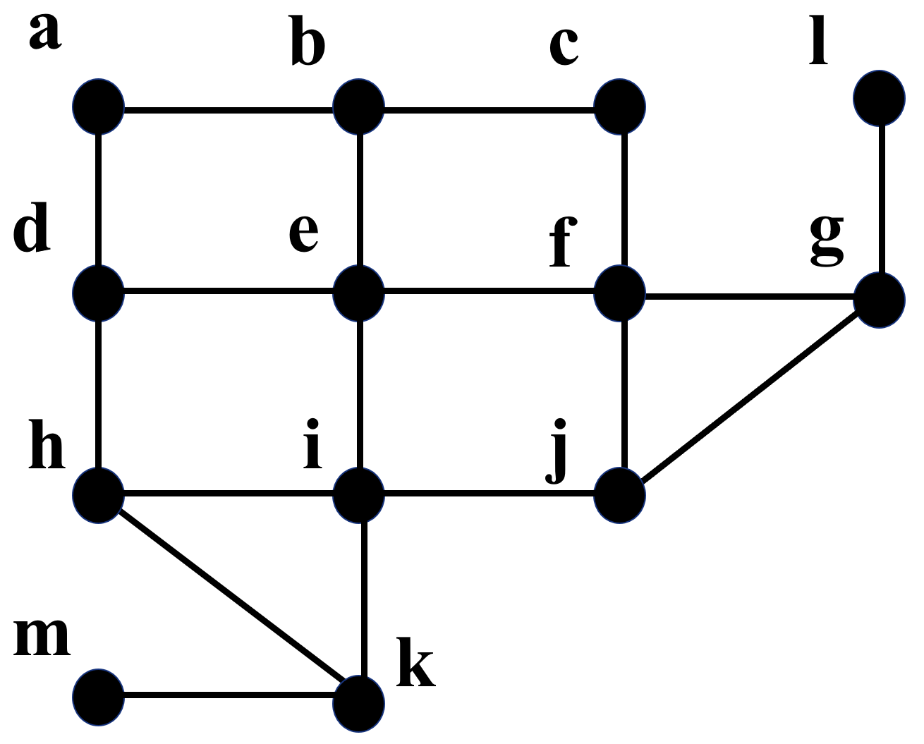
Example 5
e
b
d
f
i
a
c
g
j
h
k
l
m

Slide 30
Algorithm 1 : Breadth-First Search
Procedure BFS (G: connected graph)
T := tree consisting only of the vertex v1
L := empty list
put v1 in the list L of unprocessed vertices
while L is not empty
begin
……
end

Slide 31
while L is not empty
begin
remove the first vertex v from L
for each neighbor w of v
if w is not in L and not in T then
begin
add w to the end of the list L
add w and edge {v, w} to T
end
end

Slide 32
Backtracking Application
32

Slide 33
Example 6
Graph Coloring : How can backtracking be used to decide whether a graph can be colored using n color?
e
d
a
b
c

Slide 34
Example 6
Graph Coloring : How can backtracking be used to decide whether a graph can be colored using n color?
a red
d
a red, b blue
e
a red, b blue,
c red
a red, b blue,
c green
a red, b blue,
c red, d green
a red, b blue,
c green, d red
a
a red, b blue,
c red, d green, e purple
a red, b blue,
c green, d red, e green
b
c
n=4
n=3

Slide 35

Example 7
The n-Queen Problem

Slide 36
Example 8 Sums of Subsets
{ } Sum = 0
{31} Sum = 31
{27} Sum = 27
{31,7}
Sum = 38
{31,5}
Sum = 36
{27,11}
Sum = 38
{27,7}
Sum = 34
{27,7,5}
Sum = 39

Slide 37
Applications
37

Slide 38
Applications
1. Use DFS（Depth-First Search） to produce a spanning tree(choose a as the root).
e
h
i
a
c
d
b
g
f
j

Slide 39
Applications
Use DFS to produce a spanning tree(choose a as the root).
Solution: Beginning at a, we track on the vertices by letter.
e
h
i
a
c
d
b
g
f
j

Slide 40
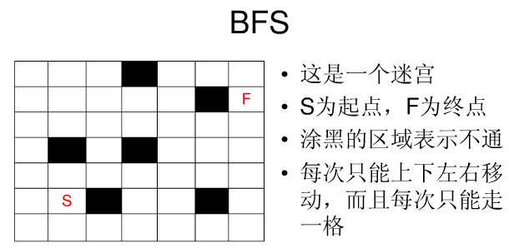
Applications
2. 求迷宫起点与终点的最短路径

Slide 41
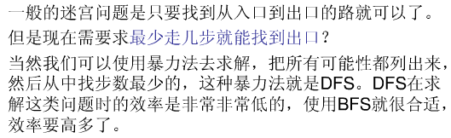
Applications

Slide 42
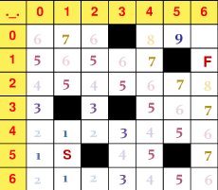
Applications
如图，采用BFS就能找到起点和终点的最短路径。

Slide 43
Exercises
1. How many edges must be removed from a connected graph with n vertices and m edges to produce a spanning tree?
生成树有n-1条边，所以需要移走m-(n-1)=m-n+1条边
Notes:
好像涉及树

Slide 44
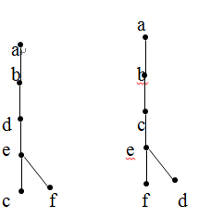
Exercises
2. Draw all the spanning trees of the given simple graph.
c
b
e
f
a
d
a
a
b
b
c
d
d
c
e
e
f
f
Notes:
好像涉及树

Slide 45
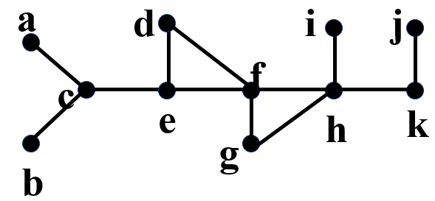
Exercises
3. Please find the spanning tree with f as the starting vertex (the root of the spanning tree) for the following graph by breadth-first search.
答案不唯一
a
d
j
i
f
c
e
h
k
b
g
Notes:
好像涉及树

Slide 46
End of Section 5.4
Click to edit company slogan .
46

